Slide 1

EDU TRACKER
By:
Harshini- Backend
Madhuri- Backend
Suryavathi- Frontend
Jyothi- Frontend
Satya- Deployment
Raghava-Deployment

Slide 2
ABOUT
The College Management System is a web-based application built using the MERN (MongoDB, Express.js, React.js, Node.js) stack. It aims to streamline College management, class organization, and facilitate communication between students and administrators.
A College Management System is an essential tool for modern educational institutions to manage their operations effectively, enhance the learning experience, and improve overall institutional performance.

Slide 3
TECHNOLOGIES USED
React JS: React is a free and open-source front-end JavaScript library for building user interfaces based on UI components. it allows developers to create reusable pieces of code that can be combined to create complex user interfaces.
Node JS: Node.js is an open-source, cross-platform JavaScript runtime environment that executes JavaScript code outside of a browser.
Express JS: Express.js is a free and open-source web application framework for Node.js. It is used to build a single page, multipage, and hybrid web application.
Material UI: is a library of React UI components that uses Google's Material Design. It includes prebuilt components, customization options, and templates for web applications.
Mongo DB: MongoDB is a free, open-source, non-relational database management system (DBMS) that uses JSON-like documents to store and process data. It's a NoSQL database solution

Slide 4
FUNCTIONALITIES
User Roles: The system supports three user roles: Admin, Faculty and Student. Each role has specific functionalities and access levels.
•Attendance Tracking: Faculty can easily take attendance for their classes, mark students as present or absent, and generate attendance reports.
•Performance Assessment: Faculty can assess students performance by providing marks and feedback. Students can view their marks and track their progress over time.
•Data Visualization: Students can visualize their performance data through interactive charts and tables, helping them understand their academic performance at a glance.
•Communication: Users can communicate effortlessly through the system.promoting effective communication and collaboration.

Slide 5
DASHBOARDS
Admin: In this we have the features of creating classes , subjects, teachers, students, notices, complaints. Admin has the access of posting marks and attendance of the students . only admin can assign the teachers and students to the class.
Faculty: In this we have the features of posting attendance and marks of the students. he can see the details of students.
Student: In this we have features of checking attendance how many subjects he is assigned with .

Slide 6
PREVIOUS APPLICATION DRAWBACKS
There is no feature available for the students to complain about the issues they have.
Students cannot view the attendance and marks in the form of visual representation(pie charts).
ADVANTAGES:
Our website has a feature called complain ,only accessible by the student by using which they can complain about their issues .Which is only visible to admin.
For the better understanding we used pie charts to represent the attendance percentage of the student .

Slide 7
Oracle Cloud Infrastructure (OCI): It is a platform of cloud services that enable you to build and run a wide range of applications in a highly-available, consistently high-performance environment.
Commands Used in Mobaxterm:
1) apt update
2) apt upgrade
3) apt install git
4) git --version
5) pwd
6) git clone https://github.com/vardhan2004/power-bill-analysis.git
7) cd /
8) curl -sL https://deb.nodesource.com/setup_18.x -o/tmp/nodesource_setup.sh
9) sudo bash /tmp/nodesource_setup.sh
10) sudo apt install nodejs
11) node -v
12) npm -v
13) cd /home/ubuntu/
14) npm start

Slide 8
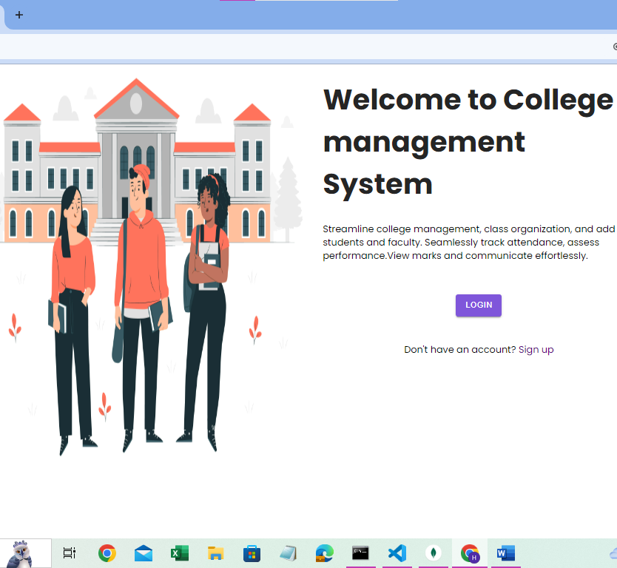
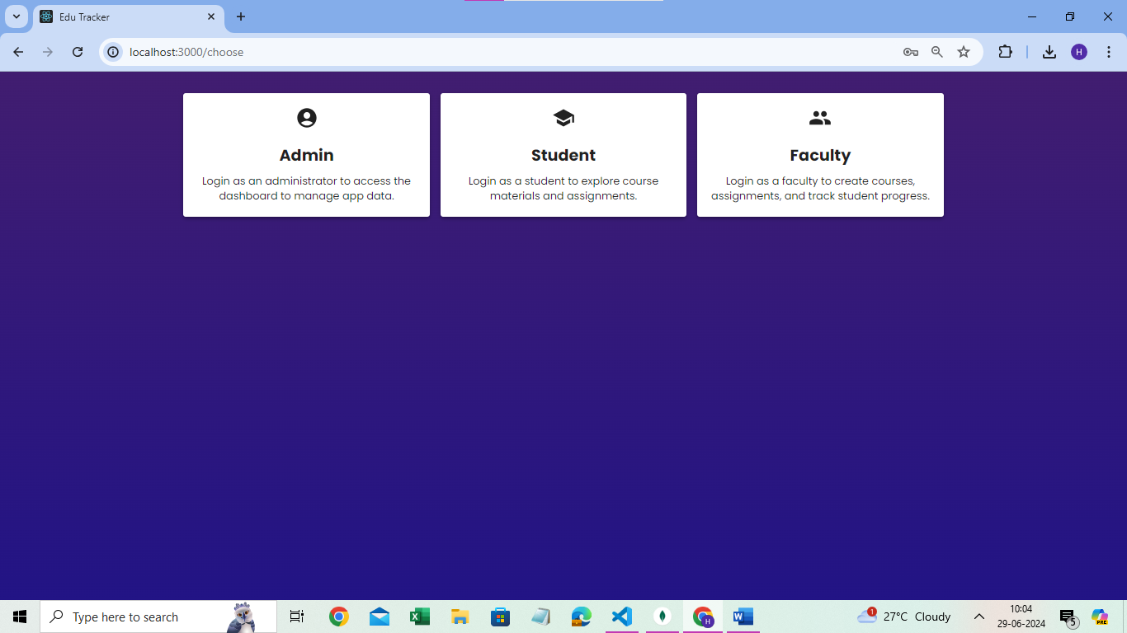
PROJECT DEMO

Slide 9
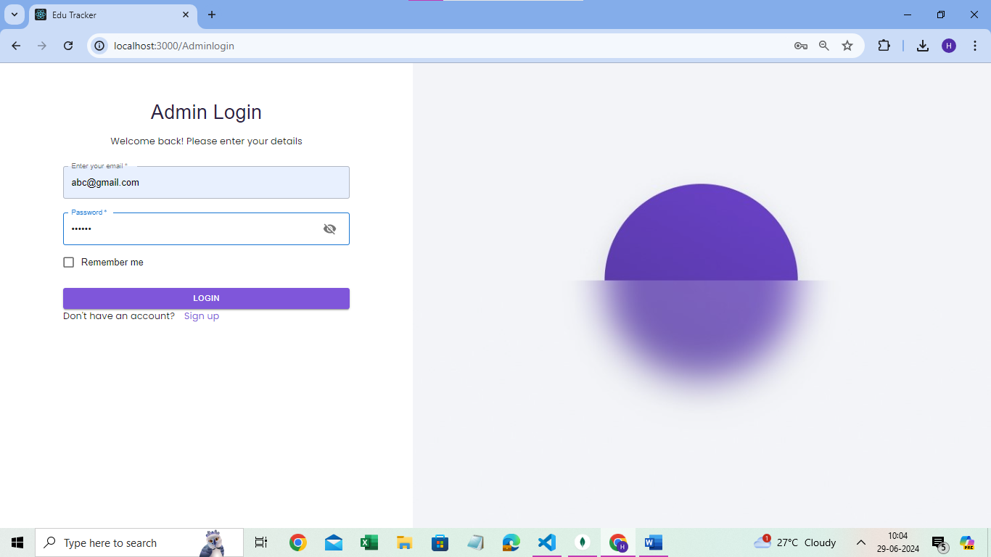
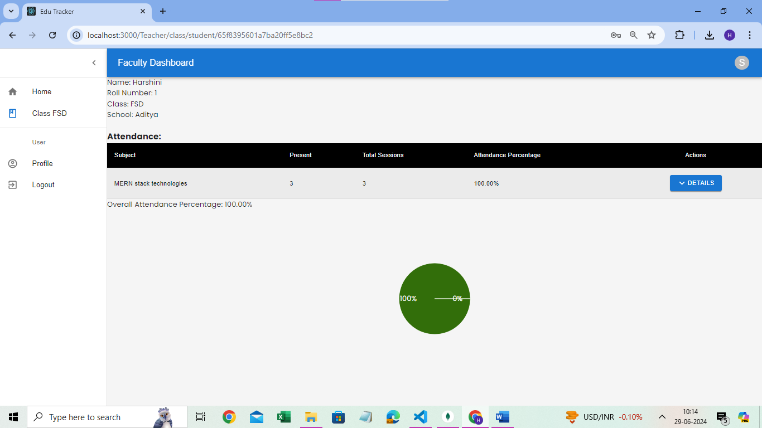
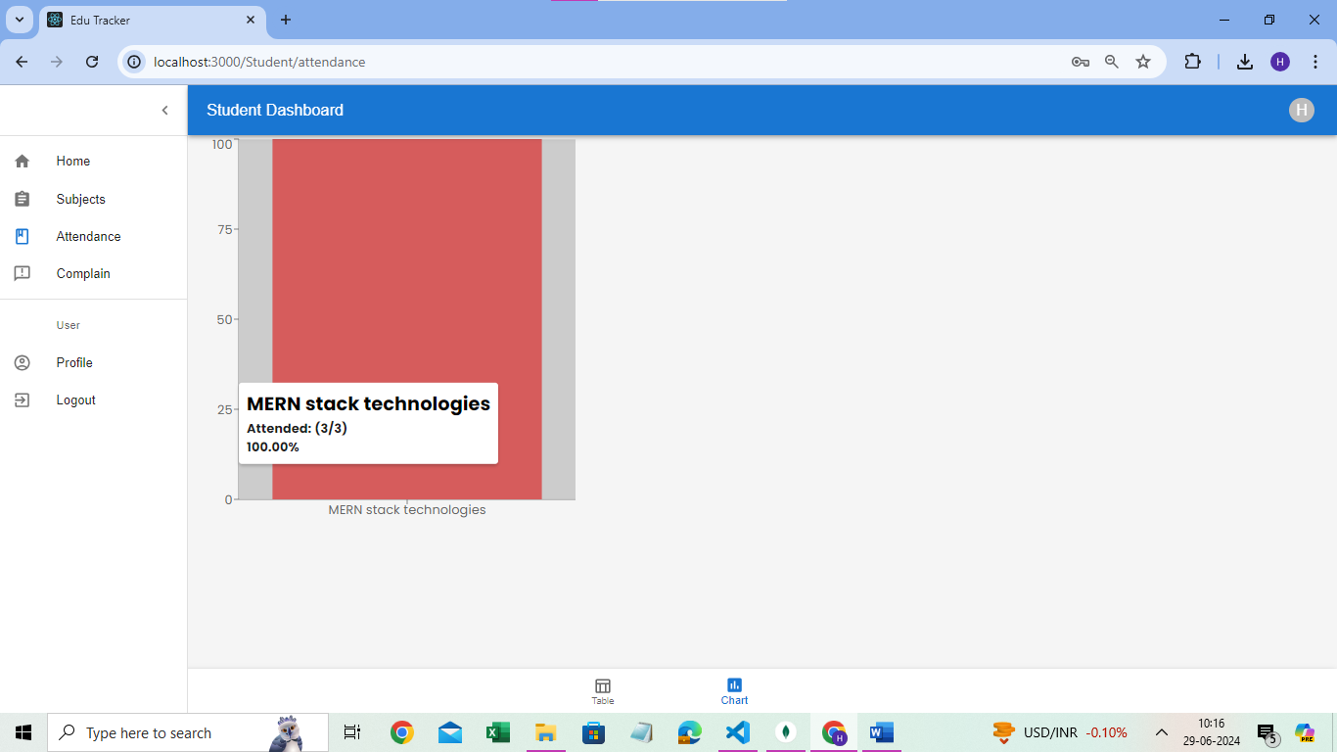
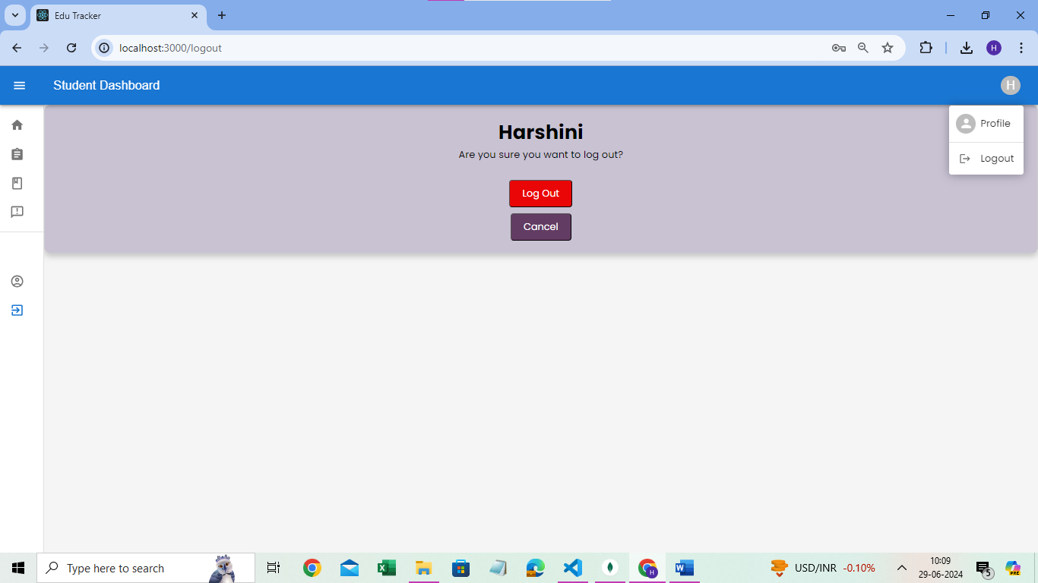

Slide 10
THANK YOU

